Slide 1
Information Security Incident Handling
Webinar 2
Incident Handling Plan and Hacker Techniques
Jeremy Koster

Slide 2
Brief Recap
The Incident Handler
Types of attackers
Why we handle incidents
Incident in the news
Information Security risk terms
Threat scenarios
Incident vs. events

Slide 3
The Incident Handling Process
Preparation
Identification
Containment
Eradication
Recovery
Lessons Learned
(Based on SANS GCIH)

Slide 4

The Incident Response Plan
Purpose
Sponsorship
Contents
Introduction
Process overview
Identification
Containment
Eradication
Recovery
Lessons learned
Contact list
Publish the plan
Test the plan

Slide 5

The Hacking Process
Reconnaissance
Foot-printing
Scanning
Enumeration
System hacking
Escalation of privilege
Extend and maintain access
Exfiltration

Slide 6

Security Testing
Define Scope
Get explicit written permission
Reconnaissance
Foot-printing
Scanning
Enumeration
System hacking
Escalation of privilege
Exfiltrate data
Write report
Method
Findings
Recommendations

Slide 7
Foot-printing – Info on the Web
General company information services
Wikipedia
Hoovers
Dun and Bradstreet
Bloomberg
Search engines
Google operators (site, link, intitle, filetype, inurl)
FTP site search engines
Archives
The Mayback Machine
Google Cache

Slide 8
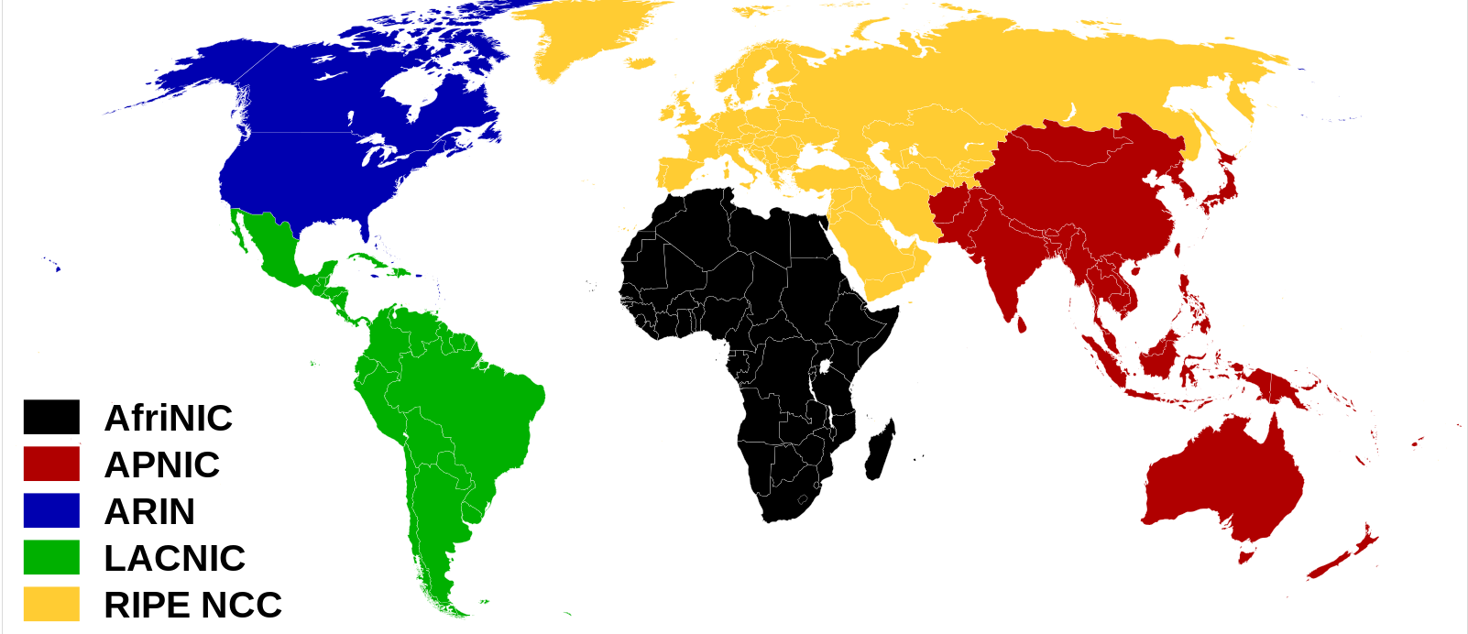
Foot-printing – Whois and DNS
ICAN query – registrar details, admin and tech handles
IP address ownership (ISP or company, POCs)
ARIN, RIPE NCC, LACNIC, APNIC
Nslookup (set q=any, set q=ns, set q=mx)
A, NS, MX, SOA, CNAME, SRV, PTR
Smartwhois – good online utility for FQDN or IP addresses
Related domains and websites
Zone transfers

Slide 9
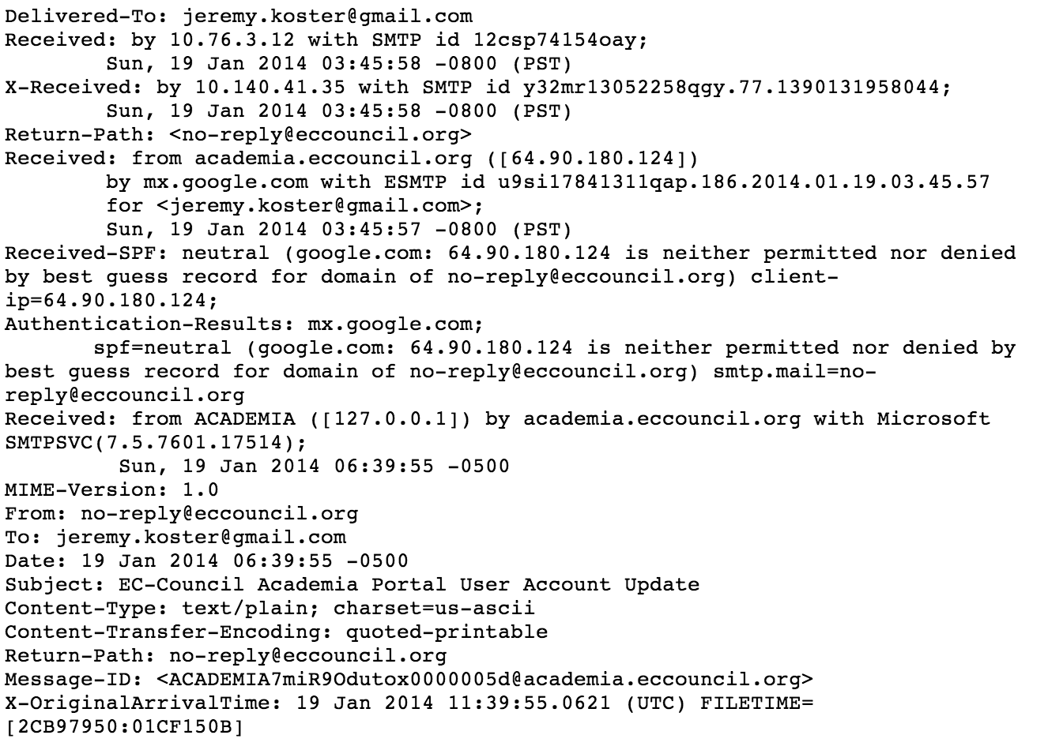
Foot-printing – Email
SMTP headers
Received
SMTP content
Web bugs
Email addresses
Scraped from web pages
Robots.txt

Slide 10
Foot-printing – Social Engineering
Convincing story
Soft target
Personal assistants
Receptionists
Temp staff
Phishing
Known email address
Internal terminology
Policy update, contact list refresh
Customer care staff
Masquerading as a customer
Details on a customer
Helpdesks
Password resets
Access passes

Slide 11
Types of Security Scanning
Modem and wireless network scanning
Network scanning
Port scanning
Vulnerability scanning

Slide 12
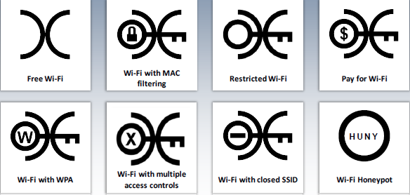
Wardialing and Wardriving
Wardialing
Identifying insecure modems
Dialling vast ranges of phone numbers
PABX, firewalls, routers, HVAC, BMS, fax machines, remote access servers
ToneLoc, THC-Scan, PhoneSweep
Wardriving
The wireless version
Drive or walk around
Wifi chalking
Identifying weak access points
Identifying rogue access points
Airsnort,Kismet, Netstumbler

Slide 13
Common TCP and UDP Ports
Categories of port numbers
Well known ports: 0 – 1023
Registered ports: 1024 – 49151
Dynamic and private ports: 49152 – 65535
Common TCP ports and services
Port 20 and 21 - FTP
Port 22 - SSH
Port 23 - Telnet
Port 25 - SMTP
Port 53 – DNS
Port 80 - HTTP
Common UDP ports and services
Port 53 - DNS
Port 69 - TFTP
Port 123 - NTP
Port 161 - SNMP

Slide 14
TCP Port Scanning
TCP Flags
SYN – Used when setting up – synchronising – a connection
ACK – Acknowledgment of traffic received
FIN – Used to gracefully close a session
RST – Resets the connection
PSH – Used to request that data be immediately pushed to the application
URG – Designated to urgent traffic
Types of TCP scans
TCP Connected – full three-way handshake
TCP SYN – flood of SYN packets looking for SYN/ACK responses
TCP FIN, NULL, Xmas – different response depending on OS
TCP ACK – RST or ICMP unreachable - firewalking

Slide 15
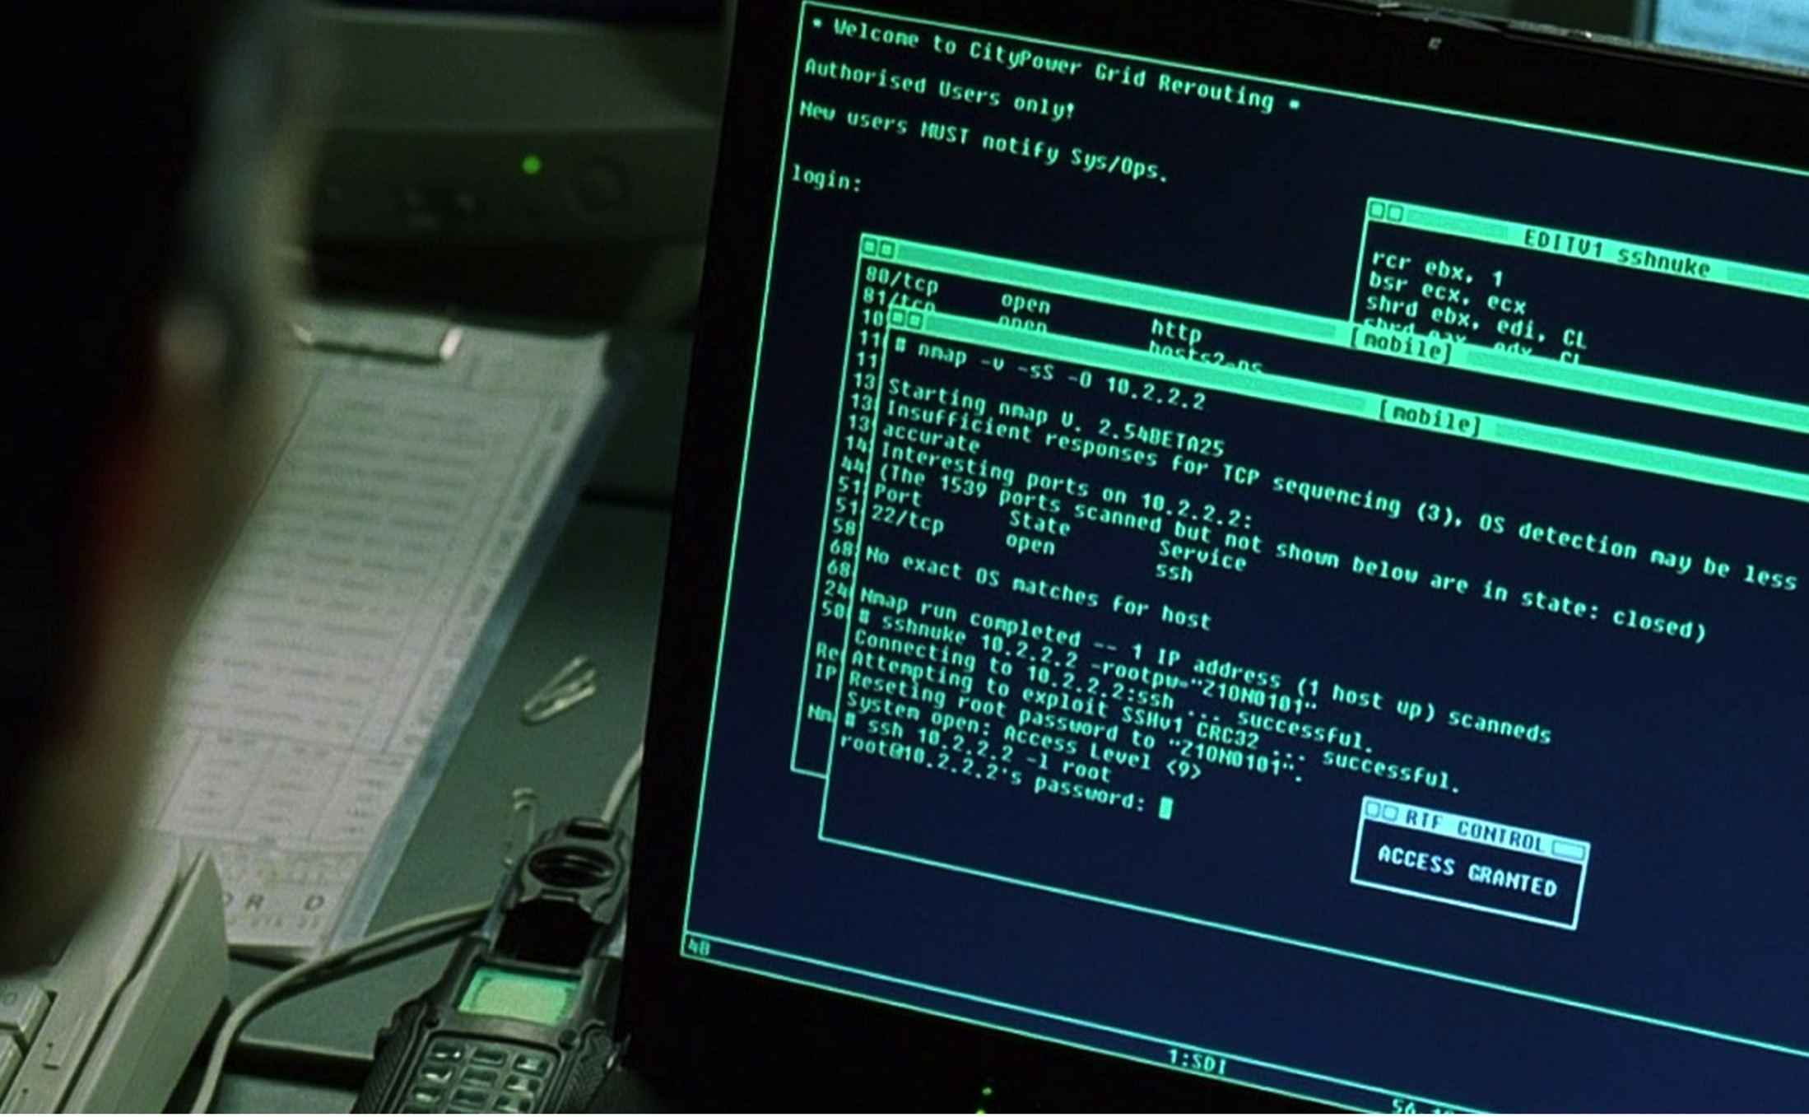

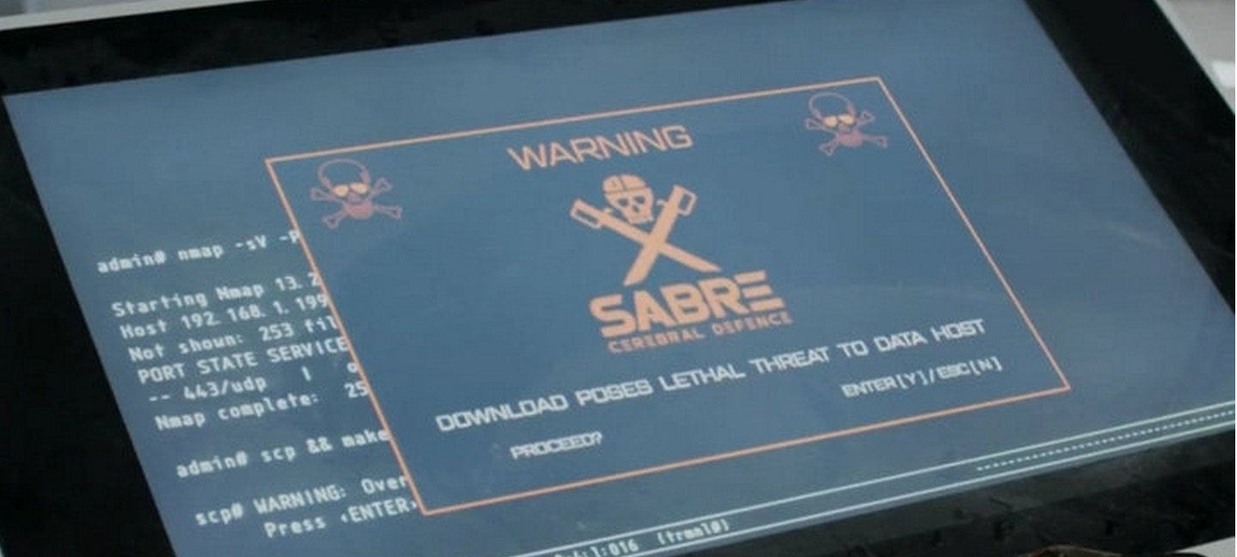
Nmap – Network Mapper
The dominant “Network Mapping” tool
Written by Fyodor
De facto tool for host and service discovery
Used by a lot of other tools
What can it do?
TCP, UDP, ARP, ICMP scans
OS fingerprinting (banners and active TCP stack profiling)
IDS evasion
The NSE - Nmap scripting engine
Bring down servers, firewalls and printers!

Slide 16
Enumeration
Vulnerabilities
Software weaknesses
Misconfigurations
Usernames
Admin, user and service accounts
Groups
Additional targets
Internal server names
IP addresses
Firewalls and IDS/IPS
Network shares
Applications and databases

Slide 17
Network Vulnerability Scanning
Network weaknesses
The weaknesses are there, it’s just a matter of finding them
Scans network segments and identifies weaknesses in services (FTP servers, web servers, network routers, etc.)
Will find issues in off-the-shelf software
Default/weak passwords, misconfigurations, open shares, insecure services)
Tools
Nessus
OpenVAS
nCircle (Tripwire)

Slide 18
Application Vulnerability Scanning
Web application scanning
Spidering
OWASP Top 10
XSS, injection flaws, CSRF
Tools
OWASP Zap (Zed Attack Proxy)
Burp Proxy
Acunetix
Grendel-Scan
Nikto

Slide 19
Password Guessing and Cracking
Password guessing (online active attack)
Obtain usernames
Online password attempts
Tools
THC Hydra
Enum
TSGrinder
Password Cracking (offline attack)
Brute-force
Dictionary
Hybrid
Rainbow tables
Tools
Pwdump
LCP
John the Ripper
0phcrack
Cain and Able

Slide 20
Discussion Questions
How can information gleaned from Google be helpful?
Why are rogue access points a cause for concern?
Why are worms considered a threat to availability as well as confidentiality?
How does a botnet operator profit from the zombies within a botnet?
If you were scanning a hosts and did not want to be noticed by IDS what evasion techniques could you use?
Why is it important to scan for vulnerabilities regularly?

